Slide 1
Parents must teach their children about whom to marry
Wylie church of Christ – VBS 2018

Slide 2
Start early…
We have a great responsibility as both Christians and parents to train our children in the way of the Lord. Part of that responsibility is teaching our children the seriousness of choosing a mate. This training must begin early in a child’s life. Why?

Slide 3
Start early…
It is during this time (from infancy to around age 18) that parents have the time, the opportunities, and the greatest obligation to so train the individual child that he or she will have the background which will compel him or her to choose for life a Christian companion. This must take place before a child begins dating for our children will marry someone they date.

Slide 4
Our Goal…
It is unwise beyond description for one to spend the years preparing to be a good, faithful, Christian marriage partner, and then marry someone who has not made the same such preparations.
We must teach our children to marry someone who will help them live faithful, Christian lives, and who will help them to “bring up their children in the nurture and admonition of the Lord.”

Slide 5
The Crisis…
Past statistics have shown that in the U.S. 50% percent of first marriages, 67% of second, and 73% of third marriages end in divorce.

Slide 6
When they understand…
The Value of a Great Marriage
The Marriage Vow
The Role of the Christian Man in Marriage
The Role of the Christian Woman in Marriage
Keys to Successful Marraiges
Failures in Marriage
What the Bible teaches about being a Father, Mother, Team
Etc.

Slide 7
These are so important…
Marriage is primarily a spiritual relationship. It is more a union of souls than of bodies. Since this is true, we would naturally expect that one’s spiritual relationship with God would affect the spiritual relationship that exists between the two marriage partners.

Slide 8
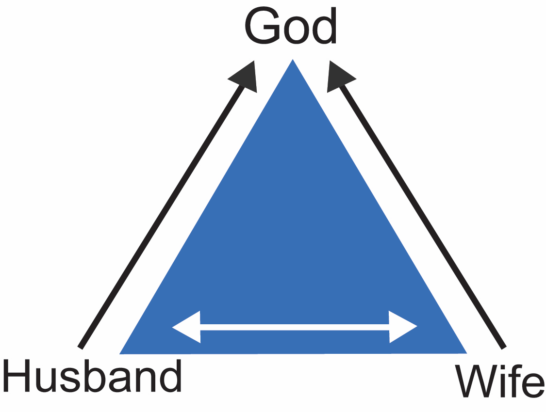

Slide 9
Marry for Love…
The three basic obligations of every person are: to love God, to love his neighbor, and to love himself (Matt. 22: 34-40)
Because love is so basic, no marriage can be truly great (ideal in God's sense of the term) unless the two people involved truly love God, each other, and themselves.
Trying to build a great marriage with people who do not love God, each other, and themselves is like trying to build a good house out of inferior lumber or crumbling bricks and mortar.

Slide 10
Why Love is So Great…
The Bible tells us that love is great - greater even than faith and hope (1 Cor. 13: 13). Love is the fulfillment of the law (Rom. 13: 10). When one truly loves another person, he treats him (her) as he himself would wish to be treated.

Slide 11
Why Love is So Great…
Love is great because it leads to right action. When a person truly loves God, he will obey what he knows to be the will of God (John 14: 15-23; 1 John 2:5; 5: 13), One can believe and yet refuse to obey God (John 12:42.43), but if he loves God, then he will obey.

Slide 12
Why Love is So Great…
Love is great because without it, even "great” things lose their value (1 Cor. 13:1-3)). Without love other great things are worthless. Paul said, "If I speak with the tongues of men and of angels, but have not love, I am become as sounding brass, or a clanging cymbal" (1 Cor. 13:1).

Slide 13
Why Love is So Great…
Love is great because with it the smallest, most insignificant things become great. A small gift given with love means much more than a larger gift given with no love.

Slide 14
Why Love is So Great…
Love is great because. when you have it, you will do the other things you should do, provided you know what to do. The man who truly loves his wife does not know of something that is good for his wife, and which will make her happy, and then refuse to do it.

Slide 15
Why Love is So Great…
Love is great because it has such transforming power. The gospel of Christ. which is the story of God's love for man, has the power to transform a degraded drunkard into a servant of righteousness.
True love has the power to transform fighting, bickering, fussing, fuming husbands and wives into people who can build their marriage into a happy one. Love opens the door to a life of happiness on this earth.

Slide 16
Why Love is So Great…
As we grow in love-for God, for each other, and for ourselves- our marriages will become greater and greater.

Slide 17
Marry a Christian…
The bible stresses oneness in a marriage, but when a Christian marries an unbeliever, the very area (spiritual area) in which oneness is needed most, will be sorely lacking. There is no greater aid to spiritual growth than biblical unity between husband and wife. Nothing is more important than spiritual growth (Matt. 6:33; Col. 3:1-2).

Slide 18
Marry a Christian…
When one partner is a Christian and the other is not, they cannot truly worship God in spirit and in truth together (John 4:24). Their attitudes toward God and his teachings are not the same. Consider such scriptures as 2 Tim. 3:16-17; 1 Peter 4:11; and 2 Peter 1:3, 21.

Slide 19
Marry a Christian…
The scriptures indicate that husbands are to “love your wives, even as Christ loved the church” and that wives are to “submit to your own husbands as unto the Lord” (Eph. 5:22, 25).
In situations where one or the other spouse has not obeyed the gospel, they have no concept of the biblical teachings, and the implications of those teachings, regarding marriage.

Slide 20
Understand Who Can Marry…
There are only three categories of people who can marry without committing sin
Those who have never been married before
Those who have previously married but whose former companion has died.
Those who have previously married, but are now divorced because their former companion was guilty of fornication.

Slide 21
Look for these Qualities…
Purity of Person
Joseph, in Genesis 39, refused to commit fornication with a woman who sought to seduce him into a highly immoral web. Notice his words in Genesis 39:9, “How then can I do this great wickedness, and sin against God?"
Romans 12:1; 1 Timothy 4:12; 1 Timothy 5:22; 1 Corinthians 6:18-20

Slide 22
Look for these Qualities…
Maturity of Mind
Marriage is for the mature. It is an institution that calls for adults to enter it. It is not for those who are just infatuated momentarily with each other because of a handsome build or attractive figure. It is for those who have established the love for one another God commands.

Slide 23
Look for these Qualities…
Maturity of Mind
All three of these verses (Genesis 2:18-24; Ephesians 5:31; Matthew 19:4-6) specifically talk about leaving your father and mother and becoming one with your spouse. If you are not mature enough to leave your father and mother and make a separate home, you are not ready for a successful marriage.

Slide 24
Look for these Qualities…
Immaturity is characterized by:
Selfishness. Interested only in yourself and those things directly affecting you.
Marked by ingratitude for the love and devotion shown to you by your spouse
Demands to have your own way – will scream or say hateful, hurtful things to get your own way.
Little or no sense of responsibility or obligation.

Slide 25
Look for these Qualities…
Immaturity is characterized by:
Inability to meet the conflicts or problems of life without bad emotional reactions. Anger, jealousy, violent temper, envy. Maturity comes with the ability to have a good disposition, kindness, and gentleness. Ability to admit when you are wrong. Manifests itself in poor physical intimacy.
Poor way of trying to get love
If my spouse loves me they will do this, or that.
When they don’t meet our expectations, we get mad

Slide 26
Look for these Qualities…
Permanency of marriage
God intends for marriage to be a lifetime union. Anyone, who does not enter into marriage with the same frame of mind, knows not God.
Matthew 19:6-9; Romans 7:2-3; 1 Corinthians 7:10-11

Slide 27
Look for these Qualities…
Spirit of selfless service
Paul’s “be ye kind” philosophy of Ephesians 4:32 is an imperative in marital relationships.
The golden rule of Matthew 7:12
The type of selflessness Christ showed

Slide 28
Look for these Qualities…
Trust
Proverbs 31:11-12 states the necessary trust needed in a marriage.
No marriage can live in the fatal surroundings of deep jealousy and malicious suspicion.

Slide 29
Look for these Qualities…
Loyalty of love
It should be the type of love Christ has for the church (Eph. 5:25)
The kind of love described in 1 Corinthians 13
The kind of love that is the bond of perfectness (Col. 3:14).
It should be a fervent love and one that freely pays its binding obligations (1 Peter 4:8; Rom. 13:8-10)

Slide 30
Look for these Qualities…
Has the proper respect for marriage and the roles the husband and wife are given by God
Husband is the head of the wife, as Christ is the head of the church
The husband is to love his wife the way Christ loves the church. Thus, the husbands love is NOT dictatorial, tyrannical, overbearing or unreasonable in nature.

Slide 31
Look for these Qualities…
Has the proper respect for marriage and the roles the husband and wife are given by God
This authority, being practiced in love, should not be disturbing or deplorable to the wife. Do we find our subjection to Christ distasteful? NO! Because of the love he has for us.
Wives are to submit themselves to the husband, as unto the Lord.

Slide 32
Look for these Qualities…
Spiritual attitude predominant in their life
Marriage is not a twosome relationship; it is a threesome arrangement. There is a triangle of marital happiness. God is at the top of the triangle, the husband at one base angle and the wife at the other base angle. When choosing a marital mate, the first question we must ask is, “will this person help me get to heaven?”
Choose someone who has a strong faith in God
True faith comes from only what the Bible says (1 Peter 1:3; Gal. 1:8-9; 2 Tim.3:16-17).

Slide 33
Make No Mistake…
Marriage, as God intended, is for those who love God and one another.
1 Peter 3:7 says, husbands and wives are “heirs together of the grace of life.” No other way can we live in such a blessed relationship, than to follow the example of Zechariah and Elizabeth. They were both righteous before God, walking in all the commandments and ordinances of the Lord blameless (Luke 1:6).

